Slide 1


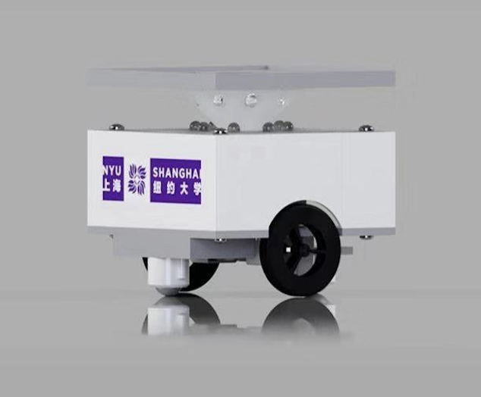
Framework for Present
Swarm Robotic Systems and New
Implementations to Increase Scalability
Rodolfo Cossovich
Zining Mao
Liyu Chen
Yuhan Yao
Thomas Yee
Into
to
Swarmesh
101
Fig. 1. Background [1]
Notes:
This is the agenda of our presentation. Let’s start with a short introduction. As you can see from the logo in this picture, we are a group of undergraduate students from New York University Shanghai. Okay, so this is our robot called swarmesh and the very focus of our project is scalability. (提纲把过渡词去掉?)

Slide 2


Motivation
Source: https://insideunmannedsystems.com/drone-light-show-planned-for-moon-landing-celebration/
Notes:
Motivation
Drone arts has been drawing attention recently with its fascinating visual effects and complicated choreography that seems almost impossible. Like you guys, our team was fascinated by the visual effect of this performance, and was have been wondering how to achieve the same thing. However, we later found that the drones were controlled using centralized system, meaning it would be very tedious to scale up or scale down. Moreover, as a group of undergraduate students, we can’t afford such a system. And then we learned the system of swarm intelligence, and found that this is a

Slide 3
Design Goals
Increase scalability
Positioning
Communication
Research-friendly
Open-source (Building tools & Project Resources)
Low-cost
Easy to build & maintain
Extensible
Notes:
Therefore, we want to build a robotics system that is more scalable
Inspired by the dancing robots from our IMA show, we came up with the project of swarm robotics. And our project has mainly two goals. The first goal stems from the scalability problem of the dancing robots, so we want to increase the scalability of our robots. The second goal comes from our life as university students. We hope our robots can be more student-friendly in aspects such as being open-source, costs, design and implementation. That way, more and more college students and even art student can be able to operate swarm robots and be inspired by technology.

Slide 4
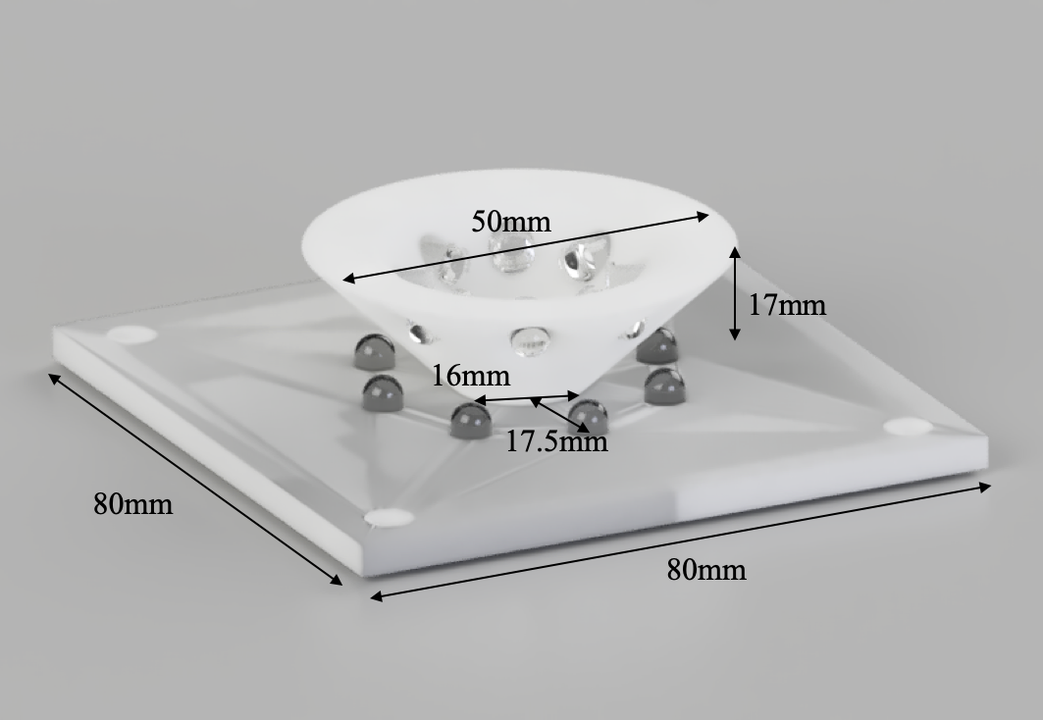
Positioning System-Design
8 Emitters & Receivers
Cone holds emitters
Plate holds receivers
45-degree angle between cone and plate
3D printable parts
Notes:
As you can see in the picture on the right, the positioning system we implemented has 8 emitters and 8 receivers. It consists of two parts, the emitting cone that holds eight emitters and the receiver plate that holds 8 receivers. The surface of the emitting cone forms a 45-degree angle with the receiving plate, with which the radiation can be reflected down 90 degrees and radiates the receivers, in order to avoid the blind spots which we are going to talk about later.

Slide 5
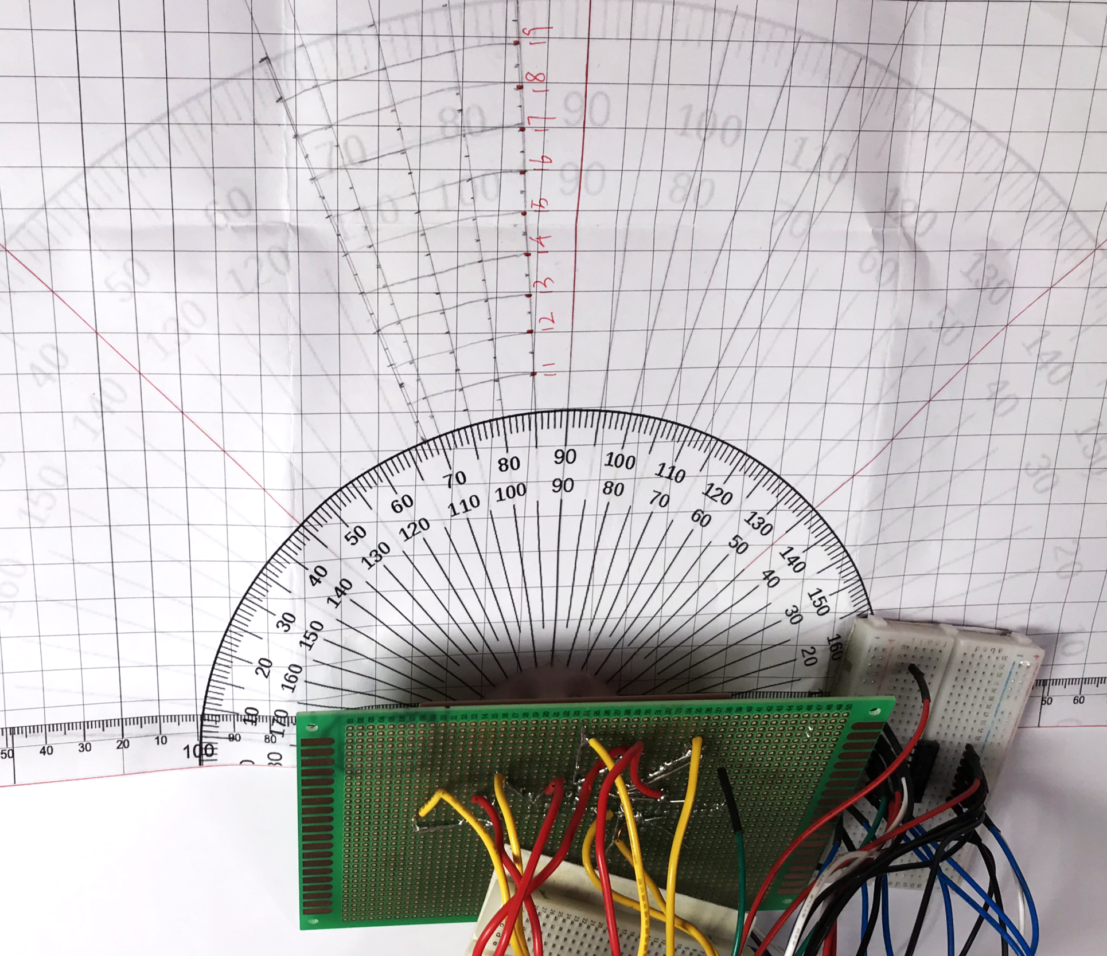
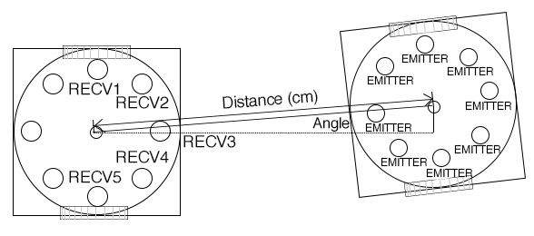
Positioning System-Test
Prototype testing
Receiving Robot
Emitting Robot
Notes:
There is one receiving robot and one emitting robot, as shown in the picture on the right. The receiving bot is fixed at the center of the bottom line, while the emitting robot emits IR signal at different locations on the test bench (Fig. 5). This test collects the voltage readings from the robot emitting IR signals. Voltage signals were measured every increment of 5-degree angles starting from the 90-degree line to the 67.5-degree line on the protractor. During the tests, one emitter on the emitting robot always points at the center of the receiving robot’s receiving cone. The voltage of receivers one to five was recorded

Slide 6
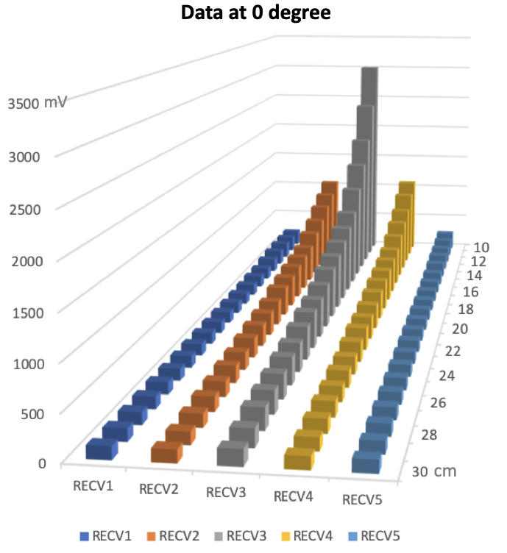
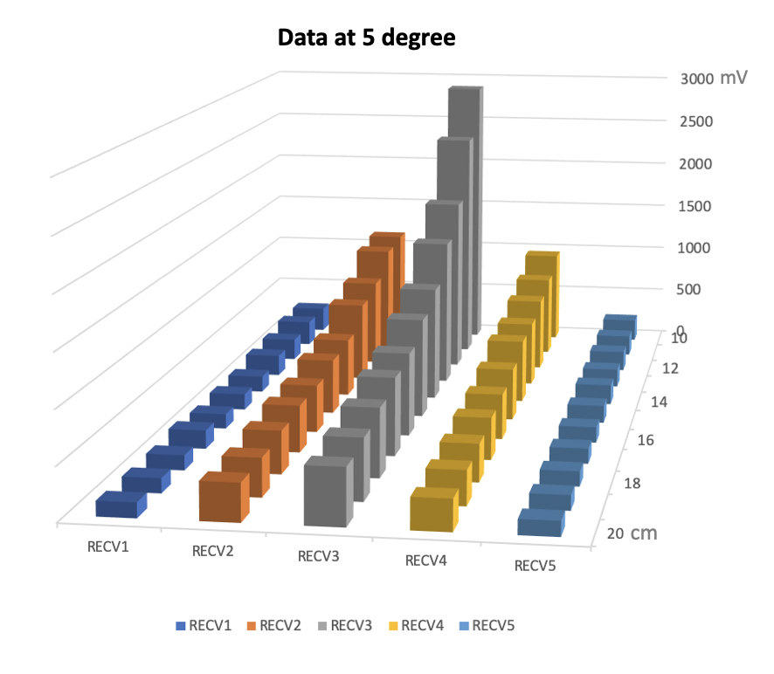
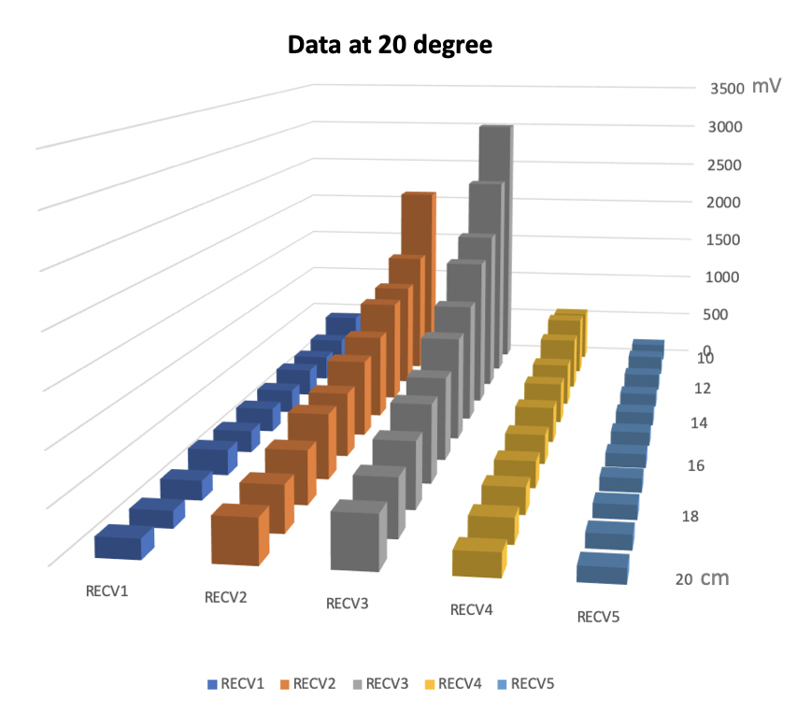
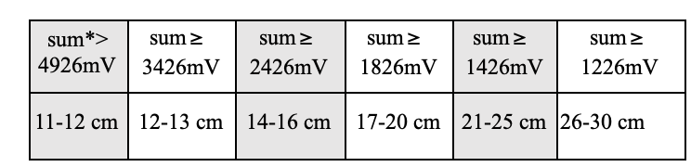
Positioning System-Test Result
Graphs of the Intensity of IR signal at different angle and distance
* sum equals the summation of all eight readings
Notes:
As you can see on the graphs, the height of the pillars represent the intensity of IR signal. Each chart has receiver 1 to 5’s voltage output taken from the distance 10 to 20 cm. According to the charts above, no matter at which angle the radiation is shooting from, the receivers always have voltage output, thus there is no blind spots in the reception area of our positioning system. We also found some interesting correlations between the sum of all voltage outputs and the distance between the receiving and emitting robot, where a range of sum corresponds to a unique range of distance.

Slide 7
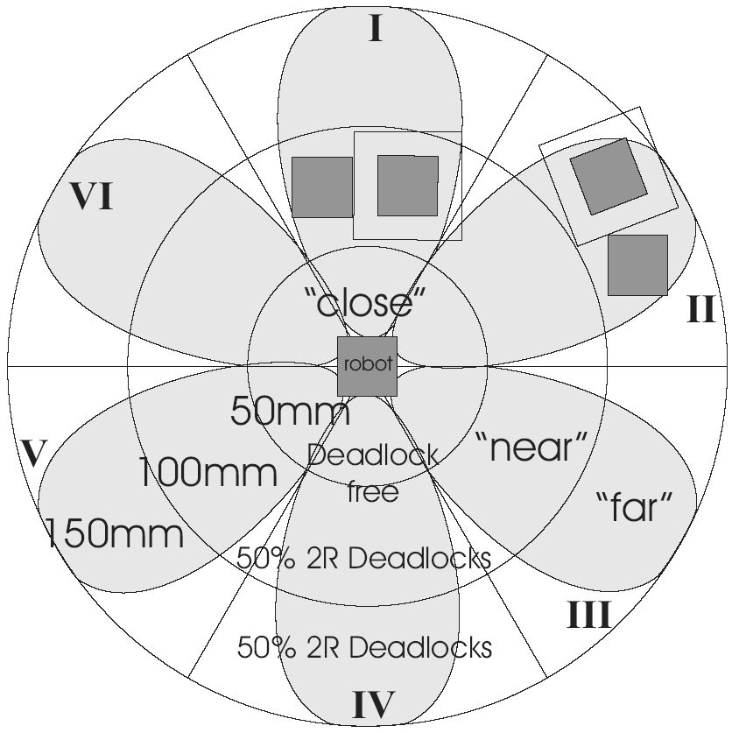
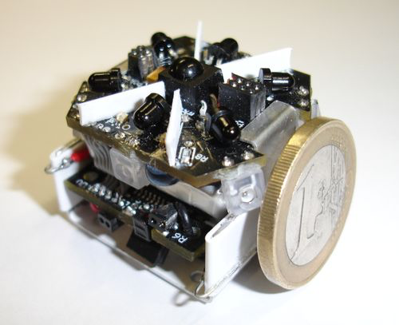
Positioning System-Comparison
The positioning system on Jasmine
Fig. 8. Jasmine [10]
Fig. 7. Jasmine IR [9]
Notes:
On existing swarm robotics systems, both emitters and receivers are facing out, such that the receivers are receiving direct radiation. However, the petal-shape receiving angle on the receiving robot will lead to the blind spots of the robot’s reception range, as shown on the picture on the left. And the blind spots adds to the time adding and dropping of swarm robots take, as the system will take longer time to recalibrate. Massive time spent on recalibration is not a good news when scaling up.
With our design, the robots are capable of receiving 360-degree IR radiation.

Slide 8
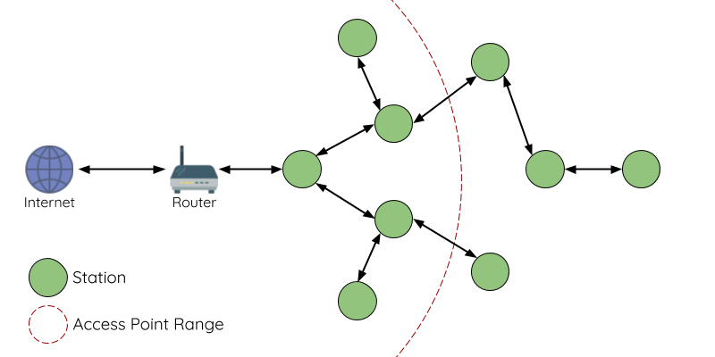
Wifi-Mesh Communication
Wifi-Mesh
Based on ESP-Mesh®
Ad hoc connection
Efficient communication
2
1
Fig. 9. Mesh Communication
Notes:
Swarmesh is using Wifi-mesh to communicate with each other. Wifi-mesh solves the two limitations of traditional Wifi structure.
The first limitation is that the router can only connect a limited number of robots, so if we cannot add more robots to the system once we reach the limited number.
The second limitation is that the router has a limited operating range, which is shown as the red line in the picture.
The reason why swarmesh does not have the two limitations is that Wifi-mesh communication uses a tree topology in which each robot can act as a router that receives messages and then pass them on to others. Therefore, we do not need to worry about the operating rage because as long as there is a valid path between two robots, you can communicate. Also, wifi-mesh makes adding and dropping robots possible and much easier. For example, robot 1 and robot 2 are not directly connected, but ….
Therefore, implementing wifi-mesh can increase scalability.

Slide 9
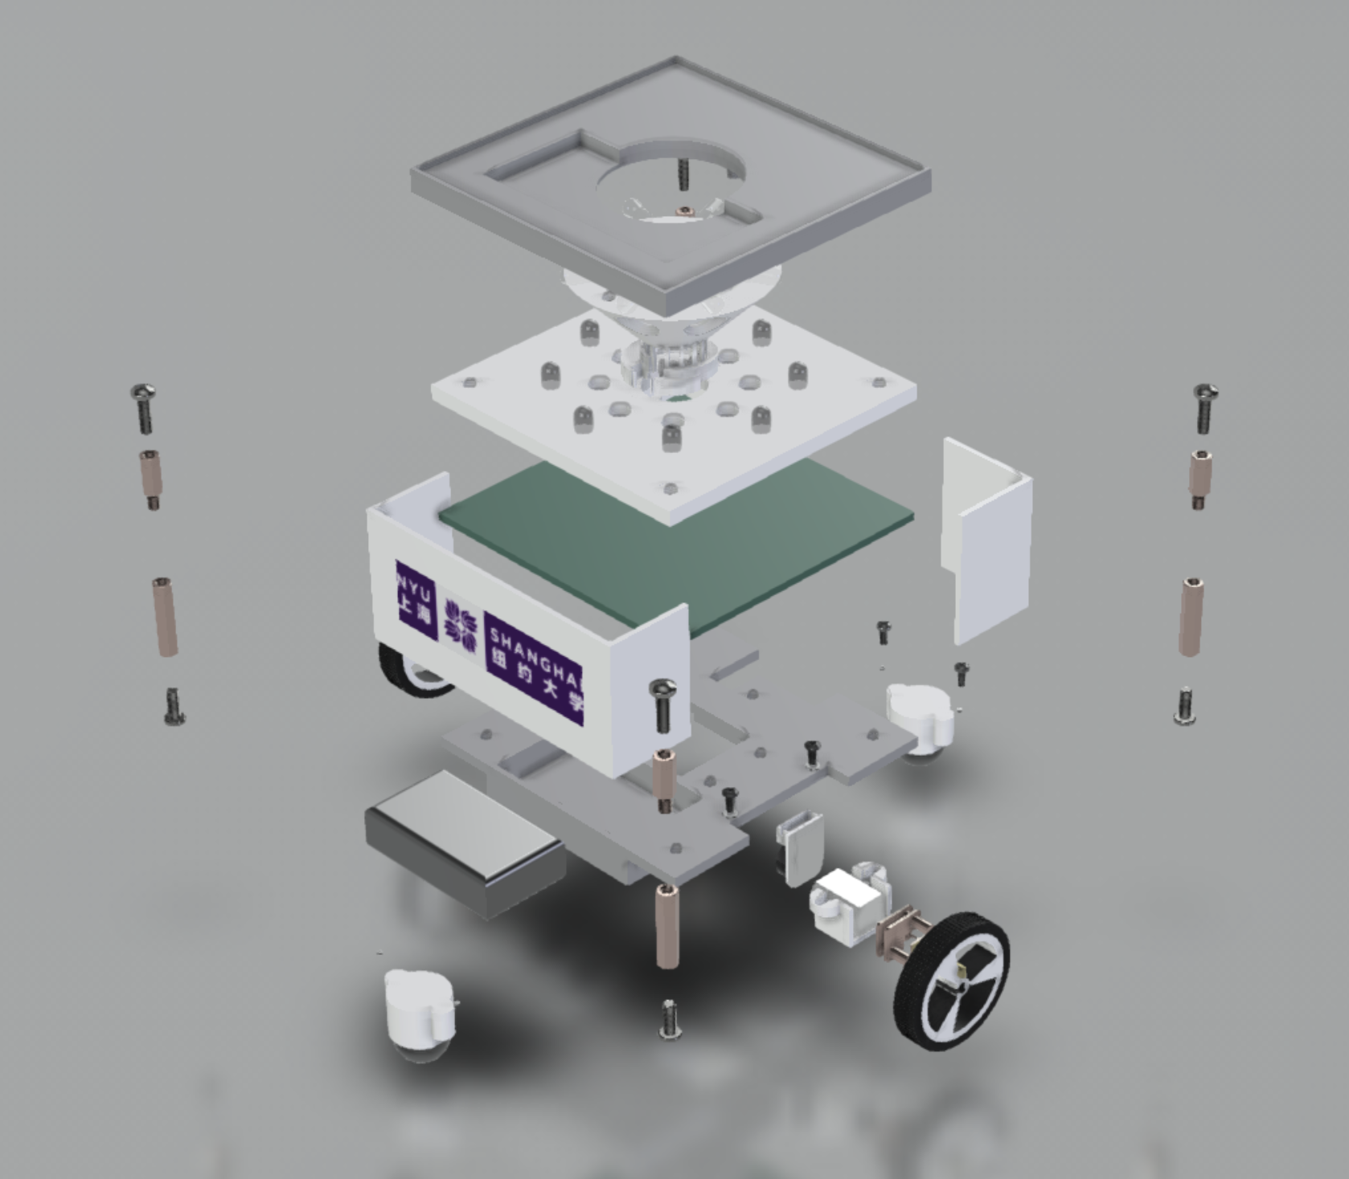
Other Design Details
8*8 LED matrix
Arduino library supported
2-wheeled robot
Notes:
Other designs of Swarmesh include LED Matrix, Arduino and locomotive.
For LED Matrix, it is not shown in this picture, but it is supposed to be on the top of the robot (show robot). Since our motivation comes from drone arts, we want our robots to able to display cool visual effects as well. We are also thinking about making the LED matrix to show the direction in which the robot is moving, the intensity of the IR and the direction of the IR it receives.
For arduino, it is easier to operate than ESP32. Our students are also more familiar with Arduino because they can learn it in class. Therefore, it is more research-friendly for university students.
Also, Swarmesh has two regular wheels and it can rotate and move forward. And the encoders on the wheels can help us keep track of the speed and the distance.

Slide 10
Demo
Task 1: Gathering
Task 2: Collective Movement
Notes:
Next, the most exciting part. The demo. We have prepared two short videos doing two tasks. The first task is gathering.

Slide 11
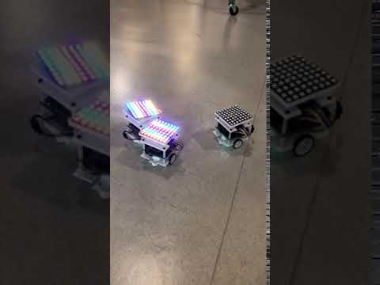
Task 1: Gathering
Notes:
As you can see here, only one robot is lightened up at first and it is rotating and emitting IR signal at the same time. Then, once other robots receive the IR signal, they will go in the direction to the central robot. Once they are in position, they are going to light up as well.

Slide 12
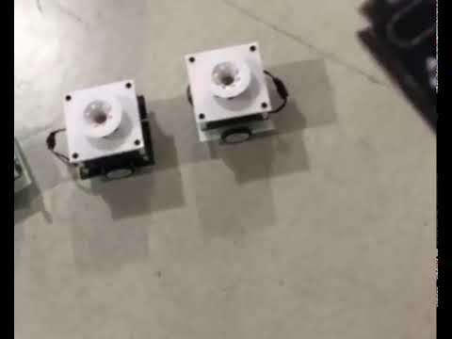
Task 2: Collective Movement
Notes:
The next task is collective movement. As you can see, the robots are perfectly synchronized. Once they receive a command, they can rotate at the same time without any time delay.
This is what we have for now and we are still working on these robots to perfect them.

Slide 13
Future Work
Failure detection of robots in the system
Collective tasks
Notes:
Our future work is more in the direction of distributed system. We hope to use our robots to research mainly two topics: failure detection of robots in the system and collective tasks.

Slide 14
Acknowledgement
This research has been supported both by NYU Shanghai Dean’s Undergraduate Research Fund.
The robot's original concept, hardware, and software development were carried out by Zining Mao, Liyu Chen, Yuhan Yao, Thomas Yee, Zhiheng Yang, and Chengxun Wu under the guidance of Professor Rodolfo Cossovich.
We would like to thank Professor Romain Corcolle and Fellow Researchers Tristan Armitage and Nicholas Andrew Sanchez for all the guidance they gave throughout the project. Special thanks to Professor Jace Hargis for his advice on this paper and Professor Olivier Marin for his advice on the presentation.
Notes:
Finally, we would like to thank everyone on this powerpoint. Not all of them can make it here today, but we want to express our gratitude to all the professors and fellows who have helped us.

Slide 15
References
[1] https://www.reply.com/en/data-robotics.
[2] https://hackaday.io/project/165119-swarmesh-nyu-shanghai.
[3] Hamann, Heiko. “Introduction to Swarm Robotics.” Swarm Robotics: A Formal Approach, edited by Heiko Hamann, Springer International Publishing, 2018, pp. 1–32, doi: 10.1007/978-3-319-74528-2_1.
[4] Fig. 2. https://www.kilobotics.com.
[5] Fig. 3. https://phys.org/news/2013-09-swarm-desktop-robotics-online-game.html.
[6] Fig. 4. http://www.swarmrobot.org/.
[7] https://docs.espressif.com/projects/esp-idf/en/latest/api-guides/mesh.html.
[8] https://www.espressif.com/en/products/hardware/modules
Notes:
Here is a list of references.

Slide 16
Thank you for listening!
Hackaday: https://hackaday.io/project/165119-swarmesh-nyu-shanghai
Github: https://github.com/todocono/swarmesh
Contact information:
yy2564@nyu.edu
lc3913@nyu.edu
zm800@nyu.edu
Notes:
Thank you so much for listening!
We welcome you to reach out to us. You can follow us on Hackaday and Github or email us directly.
Again, thank you for listening. We are glad to answer any questions.

